Slide 1
Lab 1 Addendum
DBMS
1002 and 1005
Dr. Jefferson Fong
Fall 2025

Slide 2
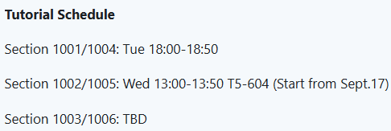
Check iSpace for updates.
If you cannot attend the tutorial of your section, you can attend the tutorial of another section.

Slide 3
Tutorials (continue)
Generally tutorials allow you more time to finish your lab exercises.
You can also ask TA for more explanations (in Chinese) on course material, but no new materials will be presented in the tutorials.
If no students show up after 15 minutes, the TA can leave.
  If you plan to be late in a tutorial, let the TA know you are coming.

Slide 4
XAMPP
In the lab, we will use XAMPP (pronounced “exemp”) to learn SQL.
If you have a laptop, install XAMPP in your laptop and bring it to the labs.
  You can use XAMPP in the lab computers, but other people might mess up the settings and change the database.
  You should use the lab computer to view the PPT containing the instructions, and use your laptop to run XAMPP.

Slide 5
iSpace > For Students > Labs > “Lab 01 – XAMPP” contains
PPT link to “Lab01 Introduction to XAMPP.pptx”,
Material link to “Lab01 Material.zip” which contains example.html and sakila.sql (the DB we use in the lab).
XAMPP Installation link to https://www.apachefriends.org for downloading XAMPP.

Slide 6
XAMPP in SWDW (Workshop 1)
SWDW used XAMPP 8.1.X.
The XAMPP Installation link to version 8.2.X. Both versions are probably should be OK for this class.
  That’s not a guarantee from me.
  You should install only one version in your computer.
  In case you wanted to recall, installation instruction for the XAMPP used in SWDW is in “COMP3013 25F” webpage under “Section 1002/1005 ” > Etc > XAMPP_installation_SWDW.

Slide 7
ToDo:
Install XAMPP on your own computer.
Follow “Lab01 Introduction to XAMPP.pptx”
There is nothing to submit this week. Get ready for next week.

